Slide 1


Speaker: Mike Jadoo

Slide 2
Agenda
About Machine Learning
Supervised Learning
R and the data science process
Fishing market dataset -Case
Supervised ML Model (Regression)

Slide 3
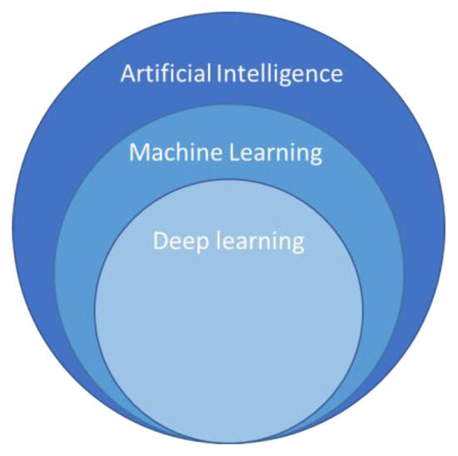
Machine Learning
Machine Learning
Unsupervised Learning
Supervised Learning
Clustering
Regression
Classification

Slide 4
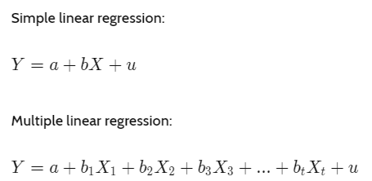
Supervised Learning
Machine Learning
Supervised Learning
Regression

Slide 5

R and Data Science process
Collection
Cleaning
Exploring
Modeling
Deployment

Slide 6
Data Story - Fishing Market

Slide 7
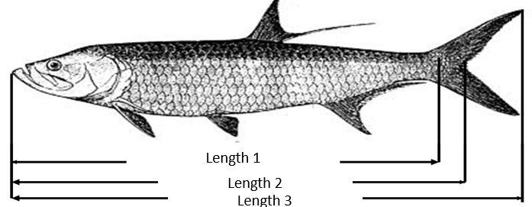
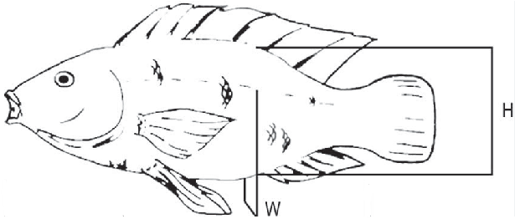

Fishing dataset -Case study
Weight

Slide 8
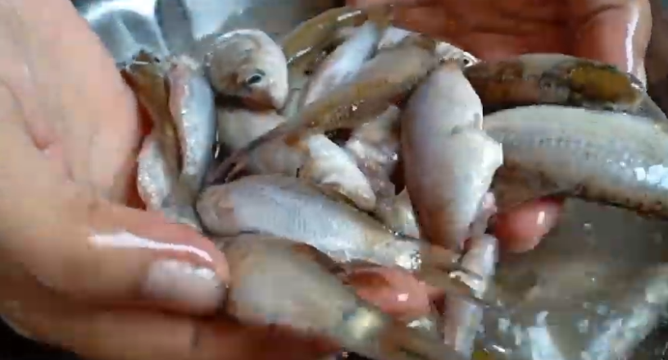
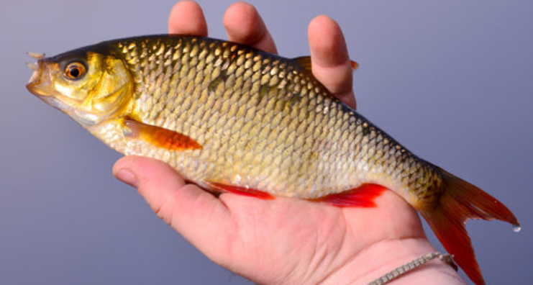
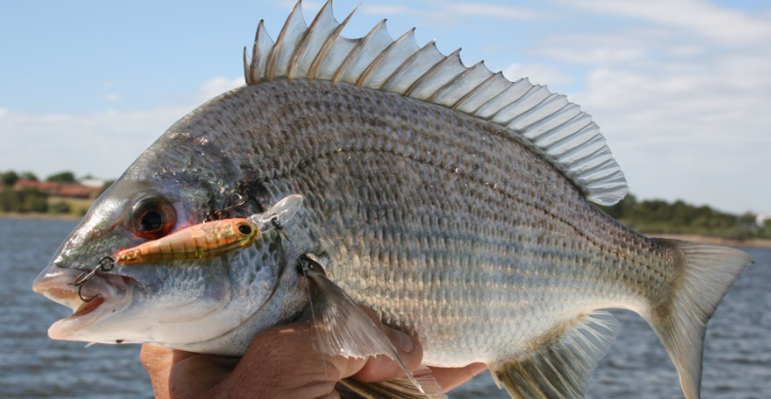
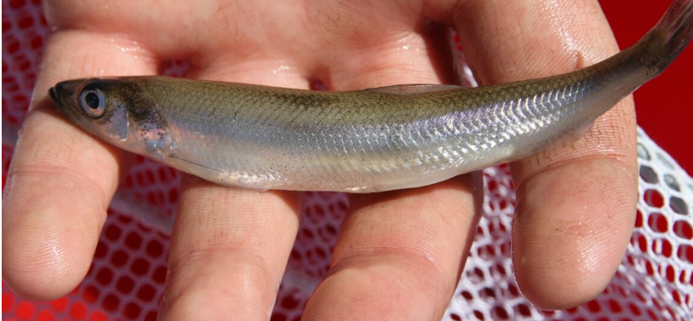



Species
Parkki
Parkki
Parkki
Parkki
Parkki
Parkki
Parkki

Slide 9
Supervised ML Model (Regression)

Slide 10

Supervised ML Model (Regression)
Cross Validation:
Types of validations:
Random Split
Time-Based Split
K-Fold Cross-Validation

Slide 11
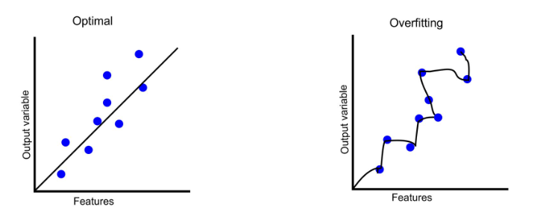
Overfitting
Training R² > Test R² = Overfitting

Slide 12
Linear Assumptions
Normality: For any fixed value of X, Y is normally distributed
Homoscedasticity: The variance of residual is the same
Independence: Observations of the independent variables are not dependent- NO Multicolinearity

Slide 13
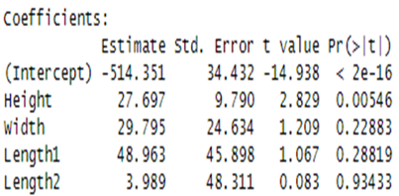
Linear model Coefficients & other output

Slide 14
Model evaluation measures
MSE – average squared difference between the predicted and actual values
RMSE-The square root of the mean squared error
R2- proportion of the variance for a dependent variable that's explained by the independent variable

Slide 15

The model-Predicting weight of a fish by certain variables
lm(formula=Weight ~ Height+ Width+Length1+Length2+ Length3, data=trainSet)

Slide 16


Slide 17
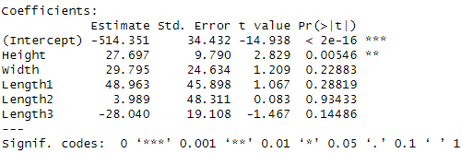
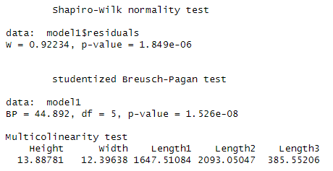
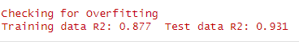
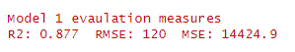
Model 1 metrics
Model parameters
Linear Assumptions
Check for overfitting
Model Evaluation

Slide 18
New model based on coefficients (Research Tip)
Some variables are not significate. What do we do?

Slide 19

New model based on coefficients (Research Tip)
Some variables are not significate. What do we do?

Slide 20
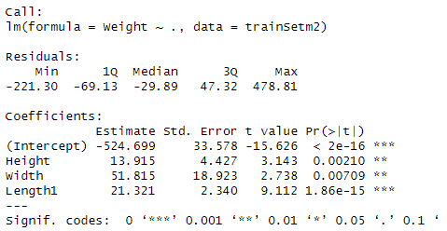
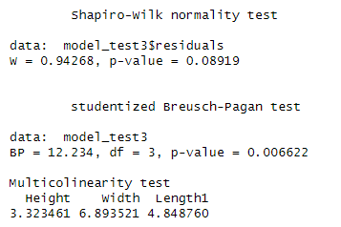
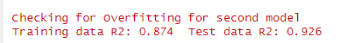
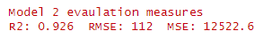
Model 2 metrics
Model parameters
Linear Assumptions
Check for overfitting
Model Evaluation

Slide 21

What did we learn? Is this the best way?

